Slide 1

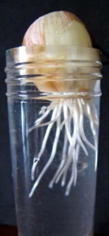
MOLECULAR GENETICS LABORATORY BT344 Experiment (1) Mitosis in onion root tips

Slide 2
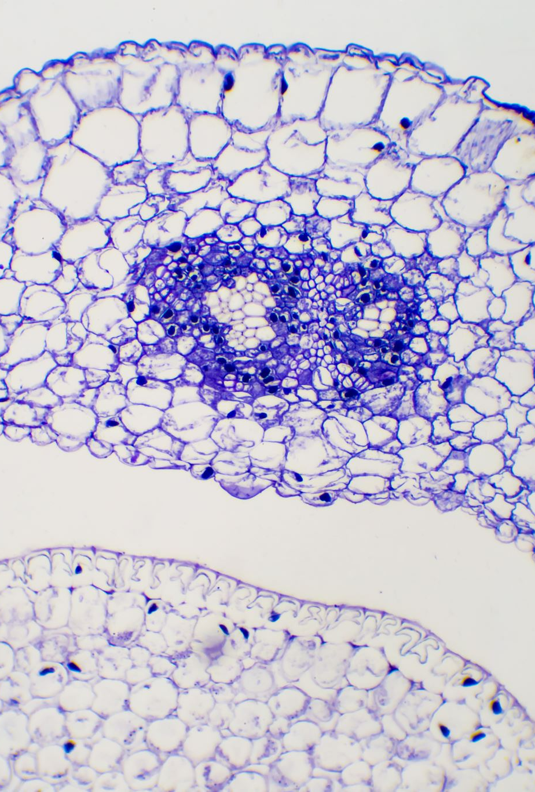
Content
Objectives
History of the cell
Cell theory principles
The cell cycle
Mitosis vs. Meiosis
Mitosis in onion root tips
Mitotic index (MI)

Slide 3
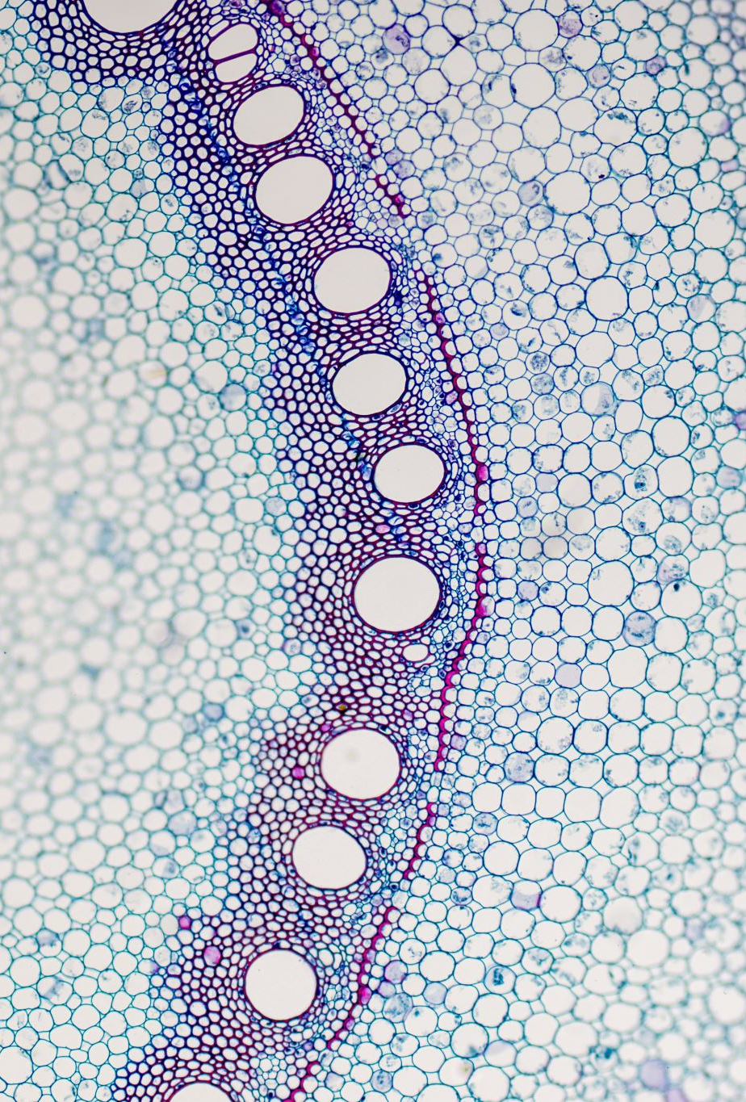
Objectives
Understand mitosis and meiosis processes.
Prepare onion root tip slides.
Visualize the stages of mitosis in onion root tip
Calculate the mitotic index (MI).

Slide 4
History of the cell
Robert Hooke (1665) was the first scientist to use the term (cell).
Robert Brown (1883) was the first scientist to use the term (nucleus).
Matthias Schleiden (1839) discovered that all plants are made up of cells.
Theodor Schwann (1838) discovered that all animals are made up of cells.
Rudolf Virchow (1855) discovered that all cells come from pre-existing cells.

Slide 5
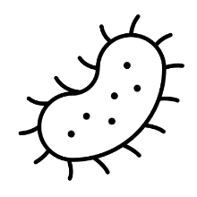
Cell theory principles
All cells come from pre-existing cell
All organisms are made of one or more than one cells
Cell is the basic, structural and functional unit in organism

Slide 6
The cell cycle
A cell cycle is a series of events that takes place in a cell as it grows and divides.
A cell cycle composed of two periods (stages):
- Interphase
- Mitosis
A cell spends most of its time in interphase,where it grows, replicates its chromosomes, and prepares for cell division. Then, the cell undergoes mitosis, and completes its division.

Slide 7
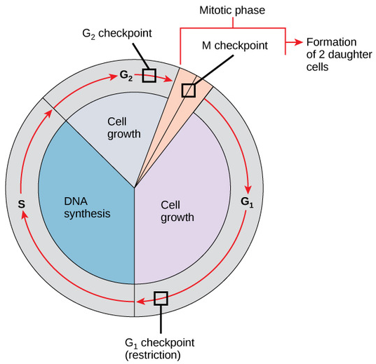
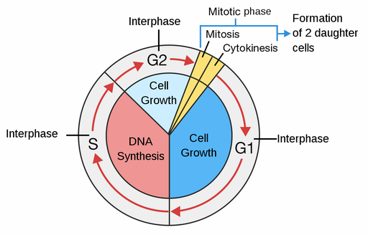
The cell cycle

Slide 8
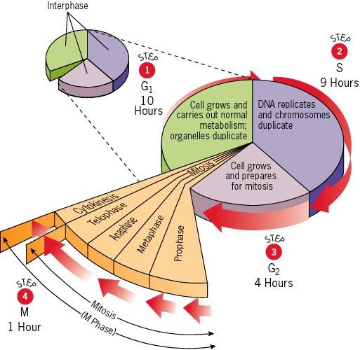

Slide 9
The cell cycle can be divided into several stages:
Interphase
Prophase
Metaphase
Anaphase
Telophase
Cytokinesis

Slide 10
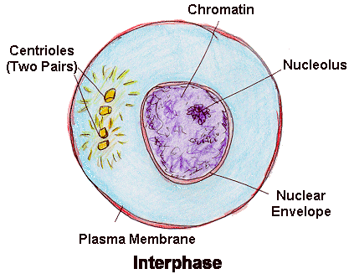
Interphase The cell prepares for division
Interphase: the longest stage and it accounts about 90% of the cycle.
1- G1 phase "first gap"
2- S phase "synthesis"
3- G2 phase "second gap"
Interphase events in animal and Plant Cells:
DNA replicated (copied)
New organelles synthesis
Cell increases in size (growth)

Slide 11
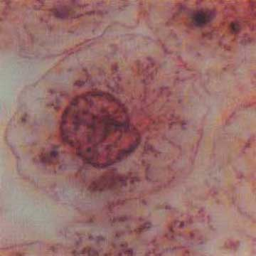
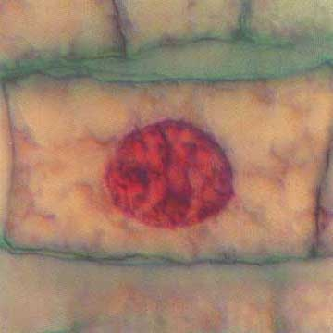
Interphase
Animal Cell
Plant Cell
Photographs from: http://www.bioweb.uncc.edu/biol1110/Stages.htm

Slide 12
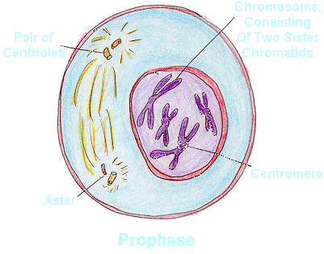
Prophase The cell prepares for nuclear division (LONGEST phase of mitosis)
Prophase events in animal and Plant Cells:
The condensation of chromosomes
The movement of the centrosomes
The formation of the mitotic spindle
The disappearance of Nuclear envelope

Slide 13
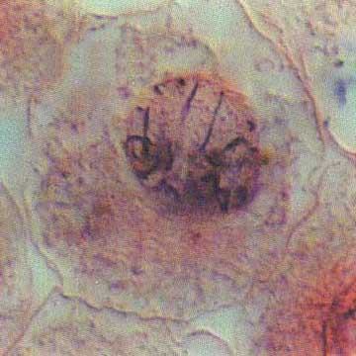
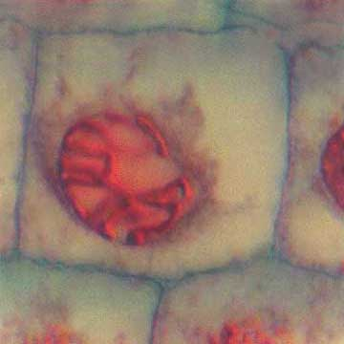
Prophase
Plant Cell
Animal Cell
Photographs from: http://www.bioweb.uncc.edu/biol1110/Stages.htm

Slide 14
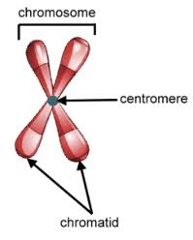
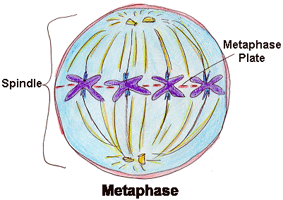
Metaphase The cell prepares chromosomes for division (SHORTEST phase of mitosis)
Metaphase events in animal and Plant Cells:
Chromosomes line up at the middle of the cell
Spindle fibers attach to chromosomes at the centromere

Slide 15
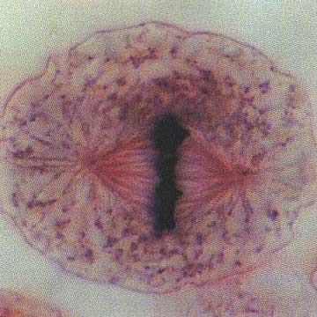
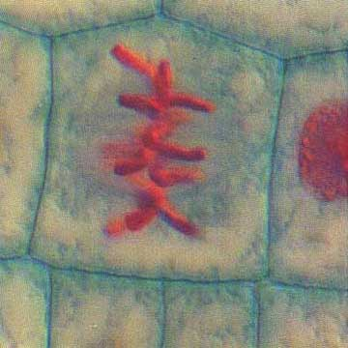
Metaphase
Plant Cell
Animal Cell
Photographs from: http://www.bioweb.uncc.edu/biol1110/Stages.htm

Slide 16
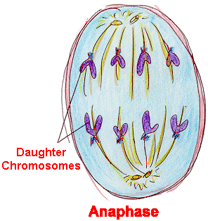
Anaphase Chromosomes division
Anaphase events in animal and Plant Cells:
Spindle fibers pull chromosomes apart from each other
½ of each chromosome (called chromatid) moves to poles of cells

Slide 17
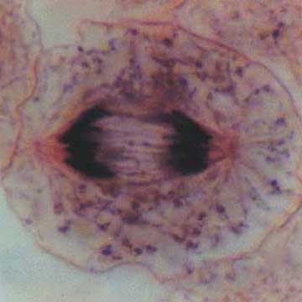
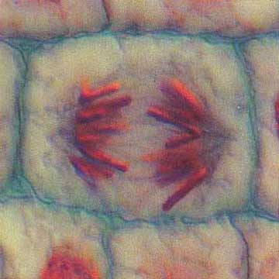
Anaphase
Animal Cell
Plant Cell
Photographs from: http://www.bioweb.uncc.edu/biol1110/Stages.htm

Slide 18
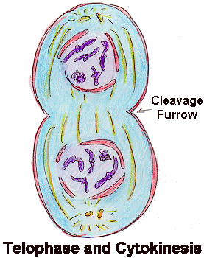
Telophase The cytoplasm division
Animal Cell:
Uncoiling of DNA & appearing as chromatin again
Formation of new two nuclei
Cell membrane pinches in to form the two new daughter cells
Plant Cell:
Uncoiling of DNA & appearing as chromatin again
Formation of new two nuclei
Formation of new cell wall between two nuclei to form the two new daughter cells

Slide 19
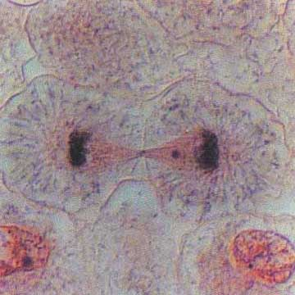
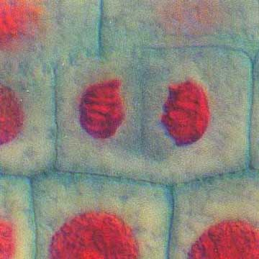
Telophase
Plant Cell
Animal Cell
Photographs from: http://www.bioweb.uncc.edu/biol1110/Stages.htm

Slide 20
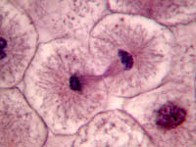
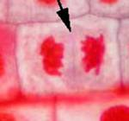
Cytokinesis
Cytokinesis: is the physical process of cell division, which divides the cytoplasm of a parental cell into two daughter cells
Begins in telophase
In animal cells: Cleavage furrow
In plant cells: Cell plate

Slide 21
The major differences between a plant cell cytokinesis and animal cell cytokinesis:
ىىى | Plant Cytokinesis | Animal Cytokinesis
Mode of Division | The cells are divided by the formation of a cell plate in the middle of the mother cell | The cells are divided by the formation of a cleavage furrow on both the sides of the mother cell
Direction of Division | The division happens centrifugally ( from the centre to the periphery) | The division happens centripetally (from the periphery to the centre)
Cell Plate Formation | The vesicles from golgi apparatus carry cell wall material to the equator of the cell and form a cell plate that moves towards the periphery of the cell. | No such event takes place in the animal cell.
Cleavage Furrow | No such event takes place in plant cells | A contractile ring is formed in the middle by the actin and myosin filaments that pull the cleavage furrow towards the centre

Slide 22
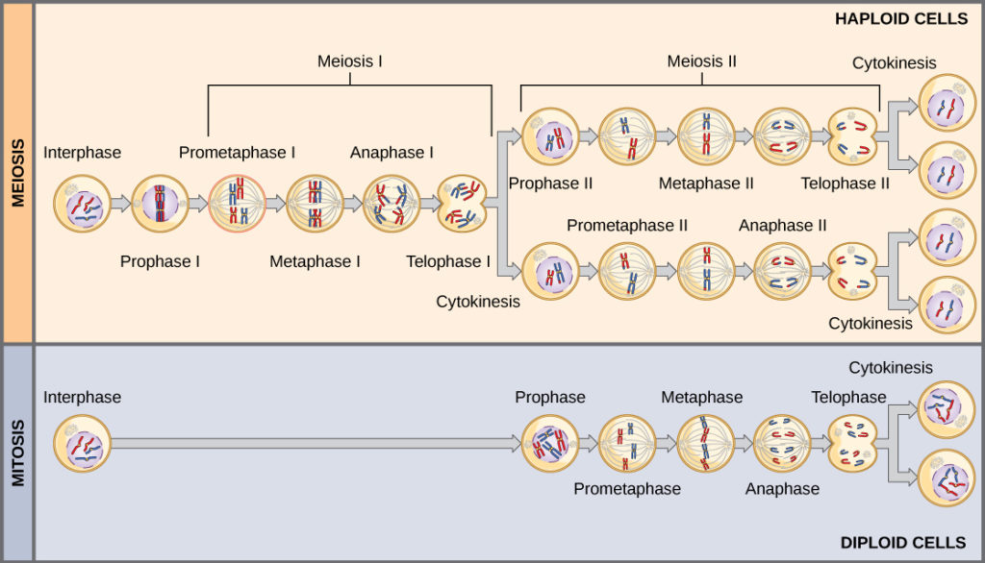
Mitosis vs. Meiosis

Slide 23
Mitosis vs. Meiosis
Property | Mitosis | Meiosis
DNA replication | Occurs during interphase before mitosis begins | Occurs during interphase before meiosis I begins
Number of divisions | One, including prophase, metaphase, anaphase, and telophase | Two, each including prophase, metaphase, anaphase, and telophase
Synapsis of homologous chromosomes | Doesn’t occur | Occur during prophase I along with crossing over between non-sister chromatids
Number of daughter cells and genetic composition | Two, each diploid (2n) and genetically identical to the parent cell | Four, each haploid (n), containing half as many chromosomes as the parent cell; genetically different from the parent cell and from each other
Role in the animal body | Enables multicellular adult to arise from zygote; produces cells for growth, repair, and in some species, asexual reproduction | Produce gametes; reduce number of chromosomes by half and introduces genetic variability among the gametes

Slide 24
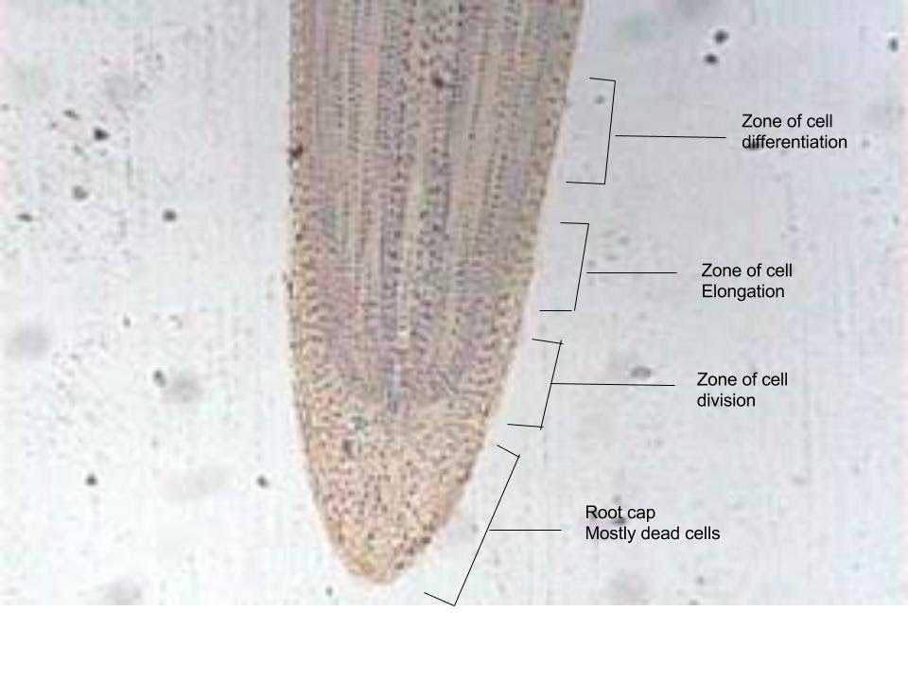
Mitosis in onion root tips
Regions of onion root tips:
1- Root cap: cells that cover and protect the underlying growth region as the root pushes through the soil
2- Region of cell division (meristem): cells are actively dividing but no increase in size
3- Region of cell elongation: cells increase in size but not in number

Slide 25
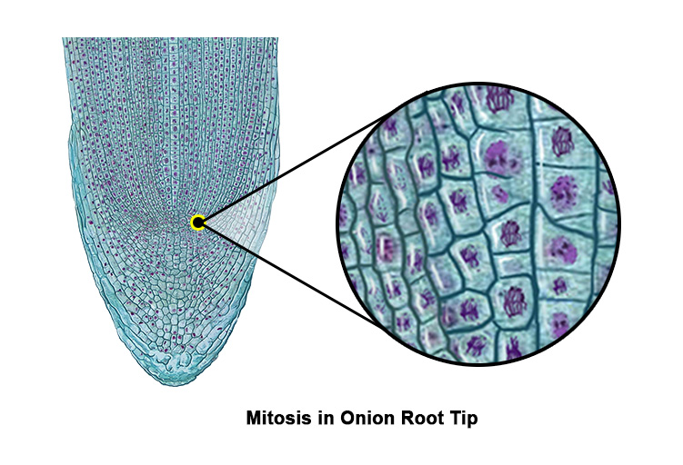
Mitosis in onion root tips:
Onion root tip after Aceto-Orcein stain
Why do we use onion root tip to study mitosis?
The roots are easy to grow in large numbers.
The cells at the tip of roots are actively dividing (meristamatic cells).
The chromosome can be easily stained (large and more visible).
The tips can be easily squashed so that the chromosomes of individual cells can be observed.

Slide 26
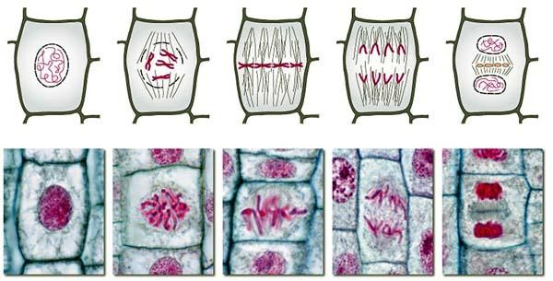
Stages of Mitosis in Onion Root tip cells

Slide 27
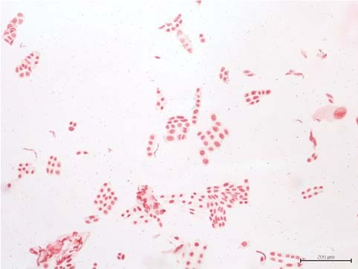
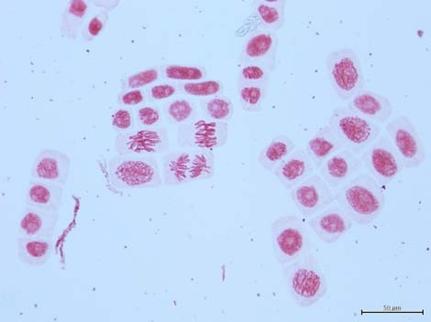
100x magnification 400x magnification

Slide 28
Mitotic index (MI)
The mitotic index: is a measure of the proliferation status of a cell population (i.e., the proportion of dividing cells).
( The ratio between the number of cells in a population undergoing mitosis to the total number of cells in a population)
The mitotic index may be elevated during processes that promote division, such as normal growth or cellular repair.
It also functions as an important prognostic tool for predicting the response of cancer cells to chemotherapy.

Slide 29
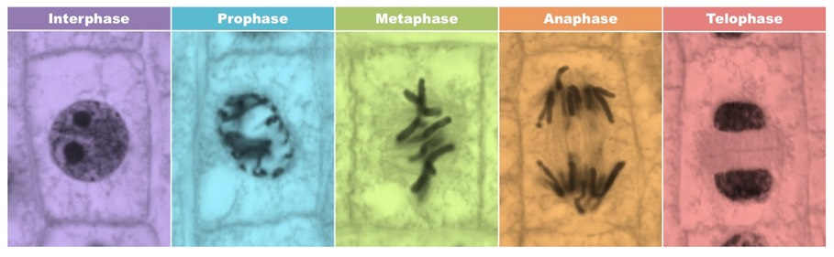
Identifying Mitotic Cells
→ Cells undergoing mitosis will lack a clearly defined nucleus and possess visibly condensed chromosomes.
Prophase – Chromosomes condensed but still confined to a nuclear region.
Metaphase – Chromosomes aligned along the equator of the cell.
Anaphase – Two distinct clusters of chromosomes apparent at poles of the cell.
Telophase – Two nuclear regions present within a single cell (difficult to see as cytokinesis occurs concurrently).

Slide 30
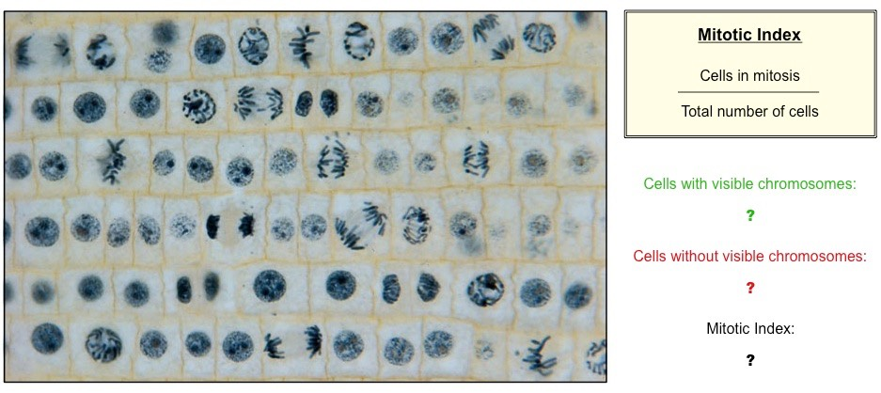
Calculating the MI

Slide 31
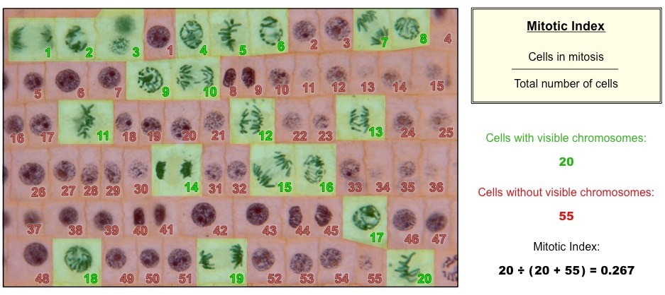
Calculating the MI

Slide 32
Calculating the MI
• Mitotic index (MI)= Number of actively-dividing cells in field of view / total number of cells in field of view
• Time of each stage = (number of cells at each stage/ total number of cells counted)* cell cycle duration for the organism (in min)
• % of time = time in each stage/ total time *100%

Slide 33
Procedure
Cut off (2-3 cm) of freshly grown roots.
Using a forceps, place one root on a clean glass slide.
Using a dropper, place one drop of 1M HCL on the root tip followed by one drop of lacto-aceto-orcein stain.
Warm it slightly on burner. Care should be taken that the stain is NOT dried up.
Carefully, blot the excess stain using filter paper.
After that, put one drop of water on the root tip.
Place a cover slip on the root tip in a 45 degrees angle.
Squash the root tip gently using your thumb.
Examine under compound microscope and observe different stages of the cell division.

Slide 34
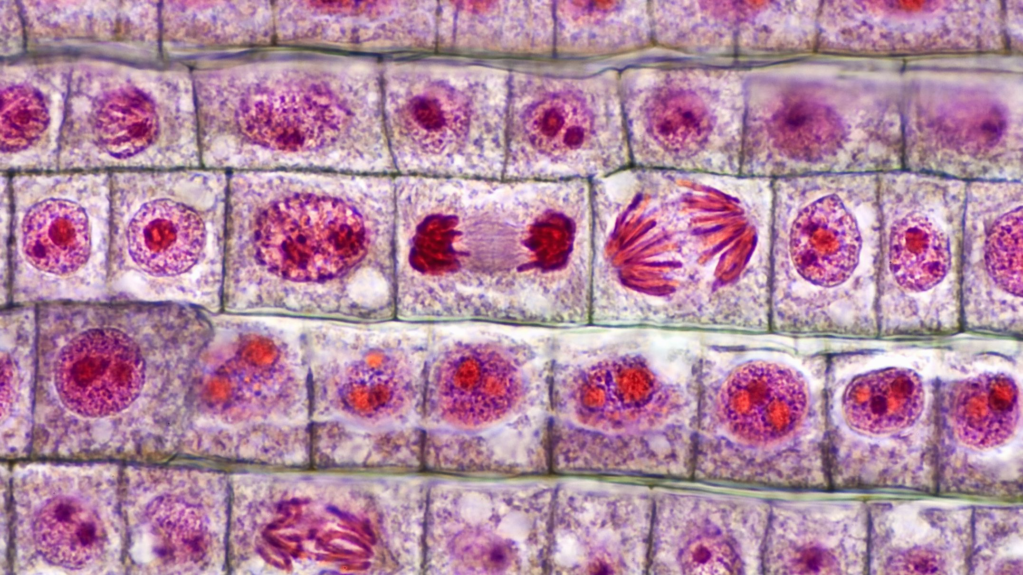
Onion root tip after Aceto-Orcein stain

Slide 35


The END

